Slide 1
This is just a placeholder side for messages and comments
Slide 2 – Added the animations and it would work on click
Slide 3 & 4: Two variants of the same slide for group activity
Slide 5: What lies beneath is “gold” for strategic communications

Slide 2

The Iceberg Theory
10%
Visible
(above the water)
Behavior, Practices & Artifacts
Music, Food….(observable to the 5 senses)
Strategic communications is looking below the water line
Relationships
Culture
Behaviors
Pride
Bias
Practices
History
Norms and rules Personal Experiences World view and Basic Assumptions
Opinions Viewpoints Attitudes Values Convictions Beliefs
90%
Not Visible
(below the water)
Iceberg Theory
“Below the line” issues
Huge & invisible.
Purposely hidden, or simply
Out of awareness
90%
Notes:
Iceberg Theory
“Below the line” issues
Huge & invisible.
Purposely hidden, or simply
Out of awareness

Slide 3
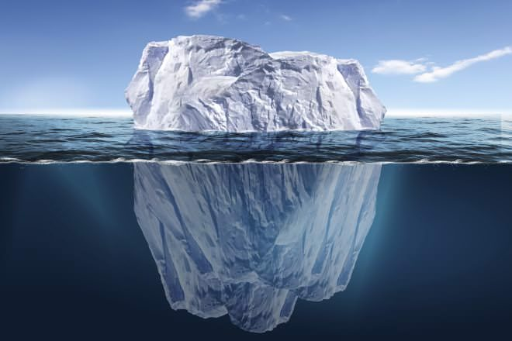
What’s beneath your waterline? Group exercise
Application

Slide 4
What’s beneath your waterline? Group exercise
Application

Slide 5
What lies beneath is “gold” for strategic communications
Individual
Punitive Justice
Achievement/Guilt
Logic
Talking Points
Bridging Trust
Transactions
Clan
Honor/Shame
Restorative Justice
Emotion
Story
Bonding Trust
Relationships

